Slide 1
Lap Time Optimization of a Sports Series Hybrid Electric Vehicle
Literature
14/04/2024, Milano
Andrea Trebbi

Slide 2
Reference
Reference paper:
Lot, Roberto & Evangelou, Simos. (2013). Lap Time Optimization of a Sports Series Hybrid Electric Vehicle. 10.13140/2.1.2166.3522.
Abstract:
The paper illustrates a method for the lap time optimization of a Sports Series Hybrid Electric Vehicle using an indirect optimal control approach. As studied during the lectures, an indirect optimal control approach means to “try to write some sort of KKT conditions” on the continuous time system, so to get a system of equations to be integrated over time. In the paper, for a vehicle with given characteristics running on a given track, the optimal trajectory and powertrain power flow that minimize the lap time are found.

Slide 3





Equations for the OCP in space domain
11
4 inputs: $u\left(t\right)={[P_{g},P_{b},P_{h},δ]}^{T}$
7 states: $x\left(s\right)={[t,Q_{b},u,v,Ω,n,α]}^{T}$
Constraints
$${Q_{b,min}≤Q}_{b}≤Q_{b,max}$$
$${i_{b,min}≤i}_{b}≤i_{b,max}$$
$${0≤P}_{e}≤P_{e,max}$$
$$P_{h}≤0$$
$$w≤n≤w_{track}−w$$
$$F_{r}^{2}+S_{r}^{2}≤{{(μ}_{r}N_{r})}^{2}$$
$$F_{f}^{2}+S_{f}^{2}≤{{(μ}_{f}N_{f})}^{2}$$
+ all other equality constraints that will be defined
$$\left\{\begin{aligned}t^{′}=\frac{1−nΘ\left(s\right) }{u\cos\left(α\right)−v sin⁡(α)} \\ Q_{b}′=−i_{b}t^{′} \\ u′=(\frac{S_{r}+S_{f}\cos\left(δ\right)−F_{f}\sin\left(δ\right)−F_{D}}{m}+Ωv)t^{′} \\ v′=\left(\frac{F_{r}+S_{f}sin\left(δ\right)+F_{f}\cos\left(δ\right)}{m}−Ωu\right)t′ \\ Ω′=\left(\frac{aF_{f}\cos\left(δ\right)+S_{f}\sin\left(δ\right)−{bF}_{r}}{I_{G}}\right)t′ \\ n′=\left(u\cos\left(α\right)+v\sin\left(α\right)\right)t′ \\ α′=\left(Ω−\frac{u\cos\left(α\right)−v\sin\left(α\right)}{1−nΘ\left(s\right)}Θ\left(s\right)\right)t′\end{aligned}\right.$$
OCP formulation
$$\min_{u}{T(s)}$$
s.t.
$$\frac{dx}{ds}=f\left(x,u,s\right)$$
$$h\left(x,u,s\right)≤0$$
$$g\left(x,u,s\right)=0$$

Slide 4

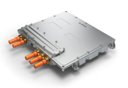
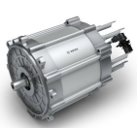
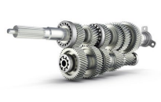

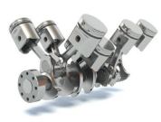
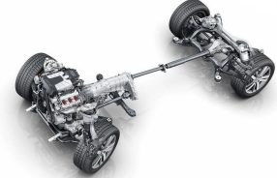




















Series Hybrid
HEV powertrain analysis
Power summation is electrical
Electrical
$2^{nd}$ power branch
$$η_{DC}$$
Mechanical
$$P_{bl}$$
$$η_{m}$$
$$η_{i}$$
Chemical
$$P_{b}$$
$$η_{t}$$
DC/DC
$$P_{i}$$
$$P_{m}$$
$$η_{ICE}$$
$$η_{g}$$
$$η_{r}$$
$$P_{r}$$
DC/AC inverter
$$P_{f}$$
$$P_{e}$$
$$P_{g}$$
$$P_{t}$$
AC/DC rectifier
$1^{st}$ power branch
We can identify 3 power branches
The battery may provide boost power while the vehicle is accelerating
However, it needs to be recharged only when the vehicle is braking
Series Hybrid vehicles are controlled so that the ICE is run at its best efficiency point
$$P_{h}$$
$3^{rd}$ power branch
Optimal power management problem

Slide 5








Series Hybrid
HEV powertrain analysis
Electrical
Mechanical
Chemical
$$P_{r}$$
DC/AC inverter
$$P_{f}$$
$$P_{e}$$
$$P_{g}$$
AC/DC rectifier
$1^{st}$ power branch
$1^{st}$ power branch – ICE power branch
For the sole purpose of optimization, under the assumption that the ICE is run at its best efficiency point, the ICE delivers its maximum available power regardless of the vehicle speed
Assumption: $η_{ICE}$ = 1 (it can be easily removed)
$P_{r}=η_{r}$ $η_{g}$ $P_{e}$
Inputs: $P_{g},P_{b},P_{h}$

Slide 6



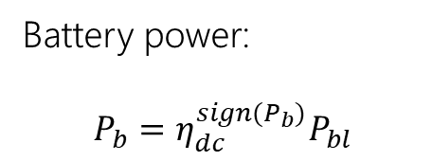


Series Hybrid
HEV powertrain analysis
$2^{nd}$ power branch
$$Q_{b}$$
$$P_{bl}$$
$$P_{b}$$
DC/DC
DC/AC inverter
$2^{nd}$ power branch – ICE power branch
Battery power:
$P_{b}=η_{dc}^{sign(P_{b})}P_{bl}$
$P_{b}=η_{dc}P_{bl}→$ if $P_{b}>0$ (i.e. energy flows from the battery to the inverter)
$P_{b}=\frac{P_{bl}}{η_{dc}}→$ if $P_{b}<0$
Inputs: $P_{g},P_{b},P_{h}$

Slide 7





Series Hybrid
HEV powertrain analysis
$2^{nd}$ power branch
Electrical
$$Q_{b}$$
$$P_{bl}$$
Nomenclature:
$Q_{b}$: SOC
$i_{b}$: current
$E_{b}$: closed circuit voltage
$E_{0}$: nominal voltage
$R_{b}$: internal resistance
$A,B$: battery constant
$$P_{b}$$
DC/DC
DC/AC inverter
$2^{nd}$ power branch – ICE power branch
$$R_{b}$$
Battery SOC :
$$\frac{dQ_{b}}{dt}=−i_{b}$$
$$i_{b}$$
$$v_{b}$$
$$E_{b}$$
Battery power (low voltage side):
$$P_{bl}=i_{b}v_{b}$$
Remark: for the battery, we could also use a static, simpler model like Panzani’s one
Closed circuit voltage ($v_{b}$):
$$v_{b}=E_{b}−Ri_{b}=E_{0}+\left(1−\frac{Q_{max}}{Q_{b}}\right)+Ae^{B\left(Q_{b}−Q_{max}\right)}−Ri_{b}$$
Inputs: $P_{g},P_{b},P_{h}$

Slide 8



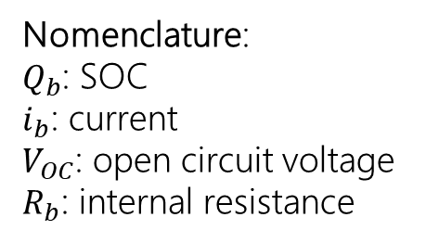


Series Hybrid
HEV powertrain analysis – Panzani Model
$2^{nd}$ power branch
Electrical
$$Q_{b}$$
$$P_{bl}$$
Nomenclature:
$Q_{b}$: SOC
$i_{b}$: current
$V_{OC}$: open circuit voltage
$R_{b}$: internal resistance
$$P_{b}$$
DC/DC
DC/AC inverter
$2^{nd}$ power branch – ICE power branch
$$R_{b}$$
$$i_{b}$$
Battery SOC :
$$\frac{dQ_{b}}{dt}=−\frac{1}{Q_{nom}}i_{b}$$
$$v_{b}$$
$$E_{b}$$
Battery current :
$$i_{b}\left(t\right)=\frac{V_{OC}}{2R_{b}}−\sqrt{{(\frac{V_{OC}}{2R_{b}})}^{2}−\frac{P_{bl}}{R_{b}}}$$
Inputs: $P_{g},P_{b},P_{h}$

Slide 9




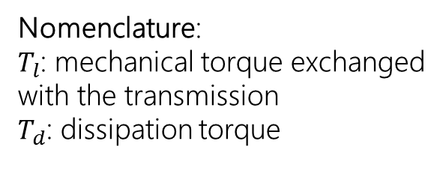


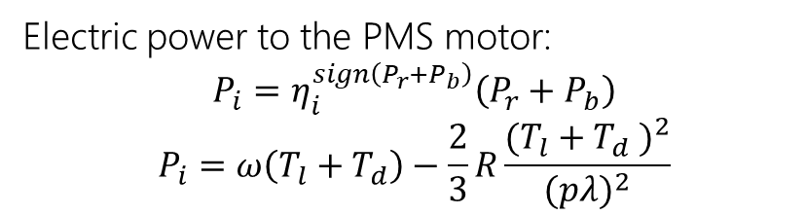



Series Hybrid
HEV powertrain analysis
$$P_{b}$$
Mechanical
$$P_{i}$$
$$P_{m}$$
Electrical
$$P_{g}$$
$$P_{r}$$
DC/AC inverter
Nomenclature:
$T_{l}$: mechanical torque exchanged with the transmission
$T_{d}$: dissipation torque
$$P_{t}$$
AC/DC rectifier
Electric power to the PMS motor:
$$P_{i}=η_{i}^{sign\left(P_{r}+P_{b}\right)}\left(P_{r}+P_{b}\right)$$
$$P_{i}=ω\left(T_{l}+T_{d}\right)−\frac{2}{3}R\frac{{(T_{l}+T_{d} )}^{2}}{{(pλ)}^{2}}$$
$$P_{h}$$
Mechanical power to the gear:
$P_{m}=$ $η_{m}^{sign\left(P_{i}\right)}P_{i}$
$$P_{m}=ωT_{l}$$
$$ω=τu$$
$3^{rd}$ power branch
Mechanical power to the vehicle
$P_{t}=$ $η_{t}^{sign\left(P_{m}\right)}P_{m}$
Inputs: $P_{g},P_{b},P_{h}$

Slide 10
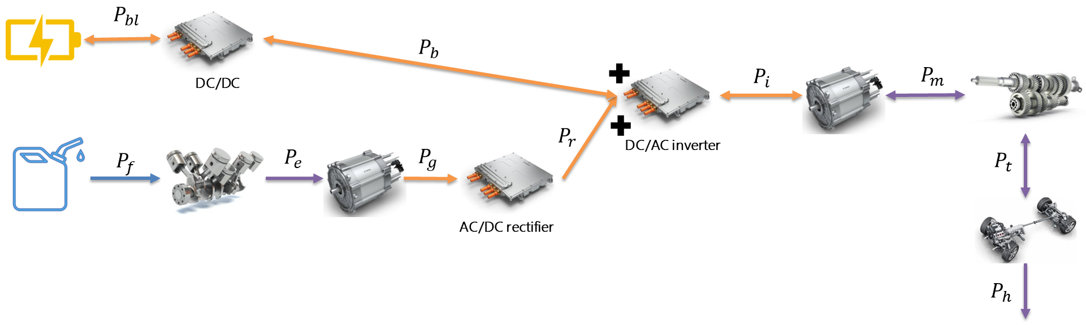

Series Hybrid
HEV powertrain analysis
Everything can be written as function of $P_{g}$, $P_{b}$, $P_{h}$. The expression for $Q_{b}$ is the only dynamical one.
$$\left\{\begin{aligned}P_{e}=η_{g}^{−1}P_{g} \\ P_{r}=η_{r}P_{g} \\ P_{bl}=η_{dc}^{sign(P_{b})}P_{b} \\ P_{i}=η_{i}^{sign\left(η_{r}P_{g}+P_{b}\right)}(η_{r}P_{g}+P_{b}) \\ P_{t}={(η_{i}η_{m}η_{t} )}^{sign\left(η_{r}P_{g}+P_{b}\right)} (η_{r}P_{g}+P_{b})\end{aligned}\right.$$
Inputs: $P_{g},P_{b},P_{h}$

Slide 11
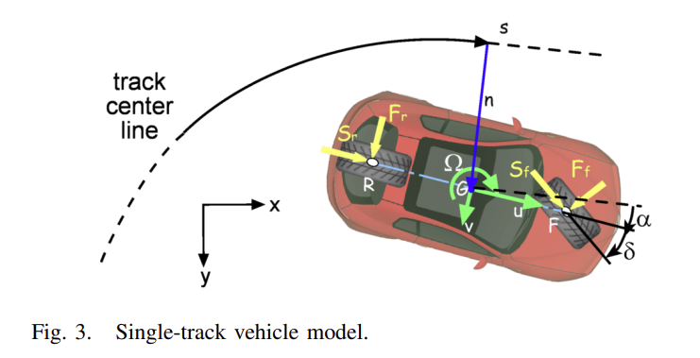

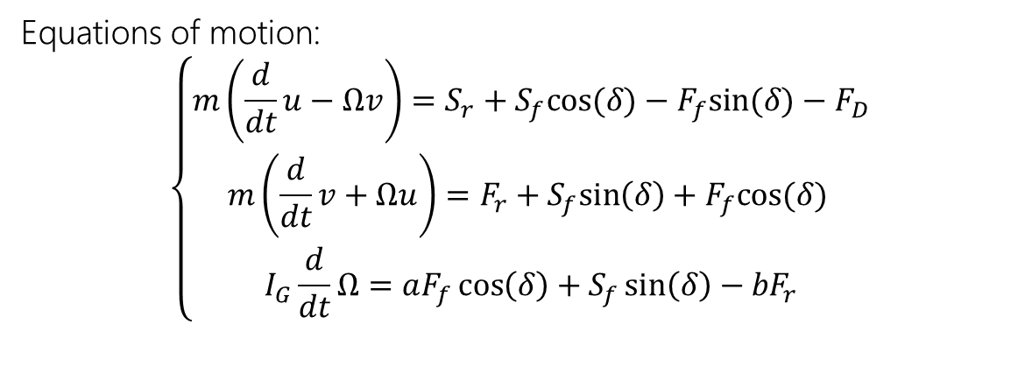
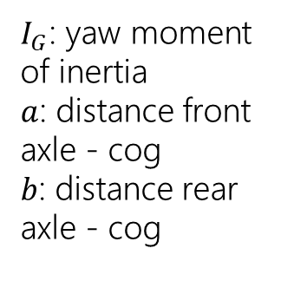

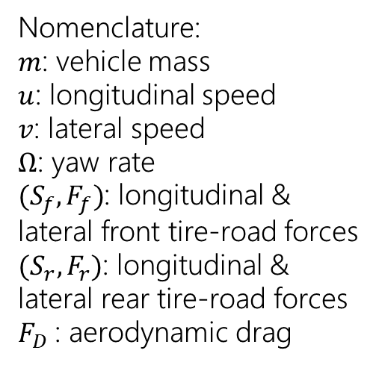
Vehicle equations
Vehicle is modeled as a single-track rigid body, running on a horizontal flat track.
Equations of motion:
$$\left\{\begin{aligned}m\left(\frac{d}{dt}u−Ωv\right)=S_{r}+S_{f}cos⁡(δ)−F_{f}sin⁡(δ)−F_{D} \\ m\left(\frac{d}{dt}v+Ωu\right)=F_{r}+S_{f}sin\left(δ\right)+F_{f}cos⁡(δ) \\ I_{G}\frac{d}{dt}Ω=aF_{f}\cos\left(δ\right)+S_{f}\sin\left(δ\right)−{bF}_{r}\end{aligned}\right.$$
Nomenclature:
$m$: vehicle mass
$u$: longitudinal speed
$v$: lateral speed
$Ω$: yaw rate
$(S_{f},F_{f})$: longitudinal & lateral front tire-road forces
$(S_{r},F_{r})$: longitudinal & lateral rear tire-road forces
$F_{D}$: aerodynamic drag
$I_{G}$: yaw moment of inertia
$a$: distance front axle - cog
$b$: distance rear axle - cog
Tire longitudinal forces: $S_{r}$, $S_{f}$
Tire lateral forces:$F_{r}$, $F_{f}$
Inputs: $P_{g},P_{b},P_{h},δ$

Slide 12






Vehicle equations
Longitudinal and lateral tire-road forces
Longitudinal forces
Lateral forces
$$S_{f}=\frac{r_{b}min(P_{t}+P_{h},0)}{u}$$
$$F_{f}=k_{f}λ_{f}≅K_{f}(δ−\frac{aΩ+v}{u})N_{f}$$
$$S_{r}=\frac{P_{t}+P_{h}−r_{b}min(P_{t}+P_{h},0)}{u}$$
$$F_{r}=k_{r}λ_{r}≅K_{r}(\frac{bΩ−v}{u})N_{r}$$
Tire loads
$$N_{f}=\frac{b}{a+b}mg−\frac{h}{a+b}(S_{r}+S_{f})$$
$$N_{r}=\frac{a}{a+b}mg+\frac{h}{a+b}(S_{r}+S_{f})$$
Inputs: $P_{g},P_{b},P_{h},δ$

Slide 13
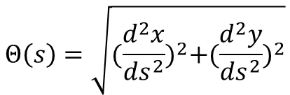




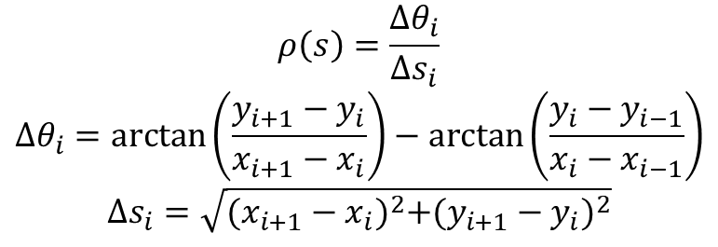
Track description
Track curvature
$$Θ\left(s\right)=\sqrt{{(\frac{d^{2}x}{ds^{2}})}^{2}+{(\frac{d^{2}y}{ds^{2}})}^{2}}$$
Vehicle position and orientation
Described by mean of 3 variables: ($s,n,α$)
Track curvature – Corno method
$$\frac{ds}{dt}=\frac{u\cos\left(α\right)−v sin⁡(α)}{1−nΘ\left(s\right)}$$
$$ρ\left(s\right)=\frac{Δθ_{i}}{Δs_{i}}$$
$$Δθ_{i}=\arctan\left(\frac{y_{i+1}−y_{i}}{x_{i+1}−x_{i}}\right)−\arctan\left(\frac{y_{i}−y_{i−1}}{x_{i}−x_{i−1}}\right)$$
$$Δs_{i}=\sqrt{{(x_{i+1}−x_{i})}^{2}+{(y_{i+1}−y_{i})}^{2}}$$
$$\frac{dn}{dt}=u\cos\left(α\right)+v sin⁡(α)$$
$$\frac{dα}{dt}=Ω−\frac{u\cos\left(α\right)−v\sin\left(α\right)}{1−nΘ\left(s\right)}Θ(s)$$
Inputs: $P_{g},P_{b},P_{h},δ$

Slide 14

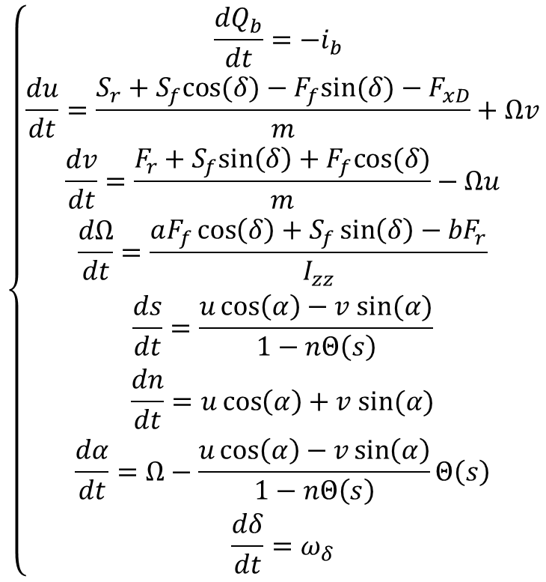
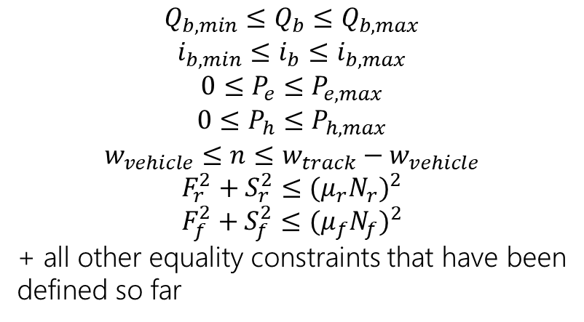

Equations for the OCP in time domain
Simplified version – powers as input
8 states: $x\left(t\right)={[Q_{b},u,v,Ω,s,n,α]}^{T}$
Constraints
$$\left\{\begin{aligned}\frac{dQ_{b}}{dt}=−i_{b} \\ \begin{aligned}\frac{du}{dt}=\frac{S_{r}+S_{f}cos⁡(δ)−F_{f}sin⁡(δ)−F_{xD}}{m}+Ωv \\ \frac{dv}{dt}=\frac{F_{r}+S_{f}sin\left(δ\right)+F_{f}cos⁡(δ)}{m}−Ωu \\ \frac{dΩ}{dt}=\frac{aF_{f}\cos\left(δ\right)+S_{f}\sin\left(δ\right)−{bF}_{r}}{I_{zz}}\end{aligned} \\ \frac{ds}{dt}=\frac{u\cos\left(α\right)−v sin⁡(α)}{1−nΘ\left(s\right)} \\ \frac{dn}{dt}=u\cos\left(α\right)+v sin⁡(α) \\ \frac{dα}{dt}=Ω−\frac{u\cos\left(α\right)−v\sin\left(α\right)}{1−nΘ\left(s\right)}Θ\left(s\right) \\ \frac{dδ}{dt}=ω_{δ}\end{aligned}\right.$$
$${Q_{b,min}≤Q}_{b}≤Q_{b,max}$$
$${i_{b,min}≤i}_{b}≤i_{b,max}$$
$${0≤P}_{e}≤P_{e,max}$$
$${0≤P}_{h}≤P_{h,max}$$
$$w_{vehicle}≤n≤w_{track}−w_{vehicle}$$
$$F_{r}^{2}+S_{r}^{2}≤{{(μ}_{r}N_{r})}^{2}$$
$$F_{f}^{2}+S_{f}^{2}≤{{(μ}_{f}N_{f})}^{2}$$
+ all other equality constraints that have been defined so far
In practice, everything can be expressed as function of the inputs.
All the equations described so far are needed to make everything consistent and to express the inequality constraints as function of the inputs and of the state variables.
4 inputs: $u\left(t\right)={[P_{g},P_{b},P_{h},ω_{δ}]}^{T}$

Slide 15


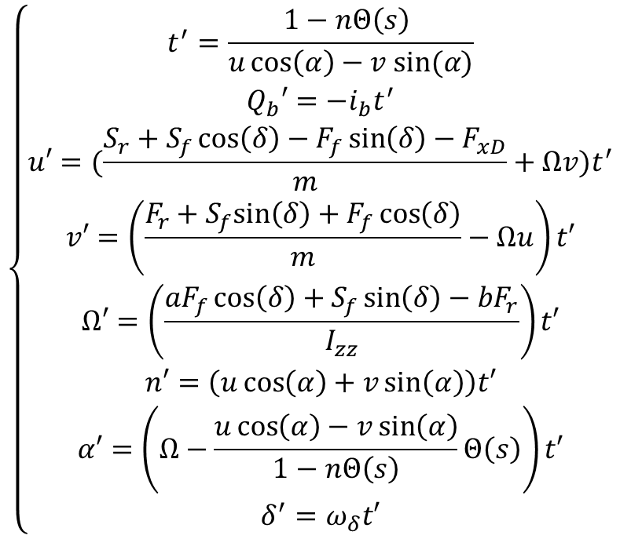
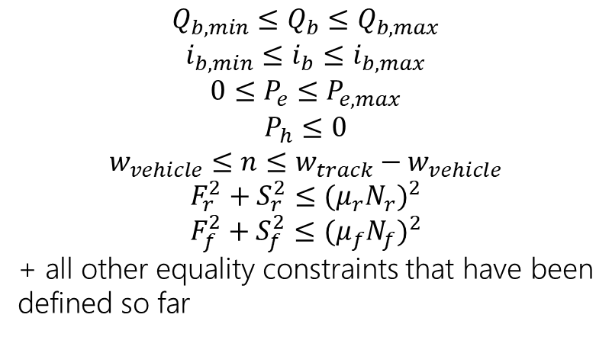
Equations for the OCP in space domain
8 states: $x\left(s\right)={[t,Q_{b},u,v,Ω,n,α, δ]}^{T}$
4 inputs: $u\left(t\right)={[P_{g},P_{b},P_{h},ω_{δ}]}^{T}$
Constraints
$$\left\{\begin{aligned}\begin{aligned}t^{′}=\frac{1−nΘ\left(s\right) }{u\cos\left(α\right)−v sin⁡(α)} \\ Q_{b}′=−i_{b}t^{′} \\ u′=(\frac{S_{r}+S_{f}\cos\left(δ\right)−F_{f}\sin\left(δ\right)−F_{xD}}{m}+Ωv)t^{′}\end{aligned} \\ v′=\left(\frac{F_{r}+S_{f}sin\left(δ\right)+F_{f}\cos\left(δ\right)}{m}−Ωu\right)t′ \\ Ω′=\left(\frac{aF_{f}\cos\left(δ\right)+S_{f}\sin\left(δ\right)−{bF}_{r}}{I_{zz}}\right)t′ \\ n′=\left(u\cos\left(α\right)+v\sin\left(α\right)\right)t′ \\ α′=\left(Ω−\frac{u\cos\left(α\right)−v\sin\left(α\right)}{1−nΘ\left(s\right)}Θ\left(s\right)\right)t′ \\ δ^{′}=ω_{δ}t′\end{aligned}\right.$$
$${Q_{b,min}≤Q}_{b}≤Q_{b,max}$$
$${i_{b,min}≤i}_{b}≤i_{b,max}$$
$${0≤P}_{e}≤P_{e,max}$$
$$P_{h}≤0$$
$$w_{vehicle}≤n≤w_{track}−w_{vehicle}$$
$$F_{r}^{2}+S_{r}^{2}≤{{(μ}_{r}N_{r})}^{2}$$
$$F_{f}^{2}+S_{f}^{2}≤{{(μ}_{f}N_{f})}^{2}$$
+ all other equality constraints that have been defined so far
In practice, everything can be expressed as function of the inputs.
All the equations described so far are needed to make everything consistent and to express the inequality constraints as function of the inputs and of the state variables.

Slide 16
Thanks!

Slide 17
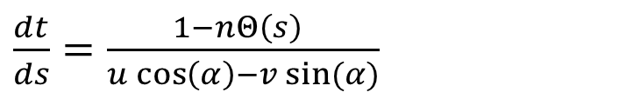

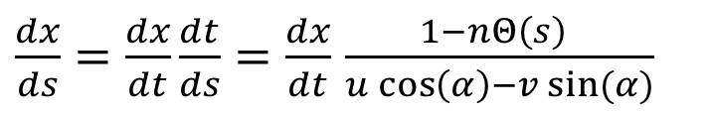



Equations for the OCP in space domain
For every state:
OCP formulation
$\frac{dx}{ds}=\frac{dx}{dt}\frac{dt}{ds}=\frac{dx}{dt}$ $\frac{1−nΘ\left(s\right) }{u\cos\left(α\right)−v sin⁡(α)}$
$$\min_{u}{T(s)}$$
s.t.
$$\frac{dx}{ds}=f\left(x,u,s\right)$$
$$h\left(x,u,s\right)≤0$$
$$g\left(x,u,s\right)=0$$
Add the time as state variable:
$\frac{dt}{ds}=$ $\frac{1−nΘ\left(s\right) }{u\cos\left(α\right)−v sin⁡(α)}$
To avoid unrealistic jerk values, it is advisable to choose as input the time derivatives of powers and steering angle:
$$\left\{\begin{aligned}\begin{aligned}\frac{dδ}{dt}=ω_{δ} \\ \frac{dP_{g}}{dt}=muj_{g} \\ \frac{dP_{h}}{dt}=muj_{h}\end{aligned} \\ \frac{dP_{b}}{dt}=muj_{b}\end{aligned}\right.$$
4 inputs: $u\left(t\right)={[P_{g},P_{b},P_{h},δ]}^{T}$
4 inputs: $u\left(t\right)={[j_{g},j_{b},j_{h},ω_{δ}]}^{T}$

Slide 18



Equations for the OCP in space domain
11 states: $x\left(s\right)={[t,Q_{b},u,v,Ω,s,n,α,P_{g},P_{b},P_{h},δ]}^{T}$
4 inputs: $u\left(t\right)={[j_{g},j_{b},j_{h},ω_{δ}]}^{T}$
$$\left\{\begin{aligned}t^{′}=\frac{1−nΘ\left(s\right) }{u\cos\left(α\right)−v sin⁡(α)} \\ Q_{b}′=−i_{b}t^{′} \\ u′=(\frac{S_{r}+S_{f}\cos\left(δ\right)−F_{f}\sin\left(δ\right)−F_{D}}{m}+Ωv)t^{′} \\ v′=\left(\frac{F_{r}+S_{f}sin\left(δ\right)+F_{f}\cos\left(δ\right)}{m}−Ωu\right)t′ \\ Ω′=\left(\frac{aF_{f}\cos\left(δ\right)+S_{f}\sin\left(δ\right)−{bF}_{r}}{I_{G}}\right)t′ \\ n′=\left(u\cos\left(α\right)+v\sin\left(α\right)\right)t′ \\ α′=\left(Ω−\frac{u\cos\left(α\right)−v\sin\left(α\right)}{1−nΘ\left(s\right)}Θ\left(s\right)\right)t′ \\ δ^{′}=ω_{δ}t′ \\ P_{g}′=muj_{g}t′ \\ P_{h}′=muj_{h}t′ \\ P_{b}′=muj_{b}t′\end{aligned}\right.$$
Constraints
$${Q_{b,min}≤Q}_{b}≤Q_{b,max}$$
$${i_{b,min}≤i}_{b}≤i_{b,max}$$
$${0≤P}_{e}≤P_{e,max}$$
$$P_{h}≤0$$
$$w≤n≤w_{track}−w$$
$$F_{r}^{2}+S_{r}^{2}≤{{(μ}_{r}N_{r})}^{2}$$
$$F_{f}^{2}+S_{f}^{2}≤{{(μ}_{f}N_{f})}^{2}$$
+ all other equality constraints that have been defined so far
In practice, everything can be expressed as function of the inputs.
All the equations described so far are needed to make everything consistent and to express the inequality constraints as function of the inputs and of the state variables.

